Slide 1
Put your OWN mask on First
November 3, 2019
Arlington, VA

Slide 2
Why do the flight attendants say: “Put your mask on first before helping others?”
Notes:
Discussion…. Look for
Have to care for yourself in order to care for others
You need to be okay before helping others

Slide 3
Compassion Fatigue ….
https://www.youtube.com/watch?v=ZsaorjIo1Yc

Slide 4
Burnout Signs
The three primary characteristics of burnout are:
emotional and physical exhaustion
depersonalization, or feelings of cynicism and detachment from one's job
and sense of lack of personal accomplishment
Source: Christina Maslach, PhD, professor in the Psychology Department, University of California, Berkeley.

Slide 5
Definitions
Compassion Fatigue Also called “vicarious traumatization” or secondary traumatization (Figley, 1995). The emotional residue or strain of exposure to working with those suffering from the consequences of traumatic events. It differs from burnout but can co-exist. Compassion Fatigue can occur due to exposure on one case or can be due to a “cumulative” level of trauma.
Burnout Cumulative process marked by emotional exhaustion and withdrawal associated with increased workload and institutional stress, NOT trauma-related.
The American Institute of Stress: https://www.stress.org/military/for-practitionersleaders/compassion-fatigue
Notes:
The Stages of Burnout have been identified as:
enthusiasm
stagnation
frustration
apathy

Slide 6
Symptoms of Compassion Fatigue
Affects many dimensions of your well-being
Nervous system arousal (Sleep disturbance)
Emotional intensity increases
Cognitive ability decreases
Behavior and judgment impaired
Isolation and loss of morale
Depression and PTSD (potentiate)
Loss of self-worth and emotional modulation
Identity, worldview, and spirituality impacted
Beliefs and psychological needs-safety, trust, esteem, intimacy, and control
Loss of hope and meaning=existential despair
Anger toward perpetrators or causal events
Notes:
NOTE to me: Definition of potentiate
transitive verb
: to make effective or active or more effective or more active

Slide 7
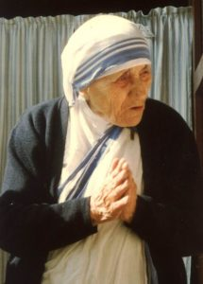
Mother Teresa Understood Compassion Fatigue
She wrote in her plan to her superiors that it was MANDATORY for her nuns to take an entire year off from their duties every 4-5 years to allow them to heal from the effects of their care-giving work.
Notes:
Do you take time off? More than just a few hours here and there?

Slide 8
Tips for Managing Compassion Fatigue
Do
Don’t
Find someone to talk to.
Understand that the pain you feel is normal.
Exercise and eat properly.
Get enough sleep.
Take some time off.
Develop interests outside of work.
Identify what’s important to you.
Blame others.
Make rash major life decisions.
Fall into the habit of complaining with your colleagues.
Work harder and longer.
Self-medicate.
Neglect your own needs and interests.
Source: Landstuhl Regional Medical Center
Notes:
NOTE to me: originally said “Develop interests outside of medicine.”

Slide 9
What do you do for self-care?
What are examples of self-care?
read a book...for pleasure
exercise
say NO to activities or people who drain you
Notes:
What do YOU do?

Slide 10
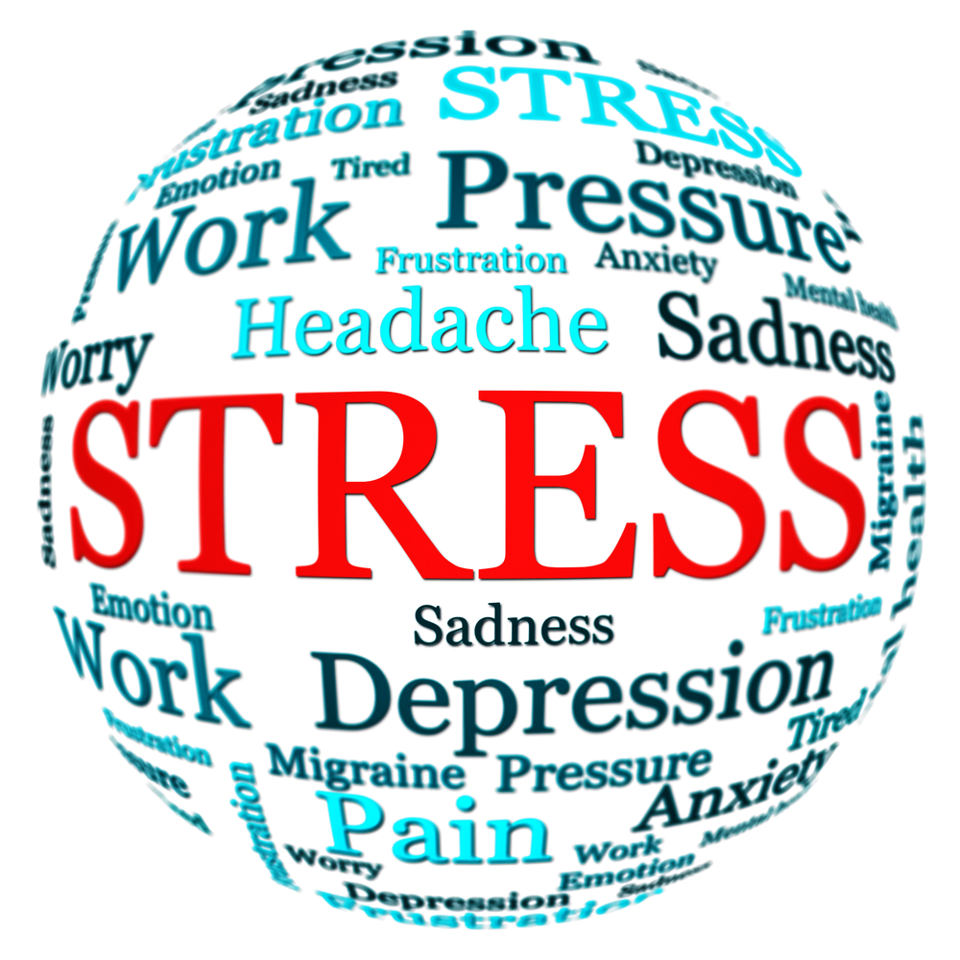
Describe situations that cause you stress. What do you do, if anything, to relieve that stress?

Slide 11
Describe activities or training you provide for volunteers that might reduce stress.
Notes:
INTERVENTIONS
•Self-recognition/acceptance of a problem
•Establish ongoing supervision and support
•Identify techniques to help you “leave your work at work”
•Identify community support groups
•Identify mental health counseling services
•Studies have also shown that a positive attitude toward life such as a sense of humor and a feeling gratitude ranked high in being helpful •Additionally, support, supervision, balancing work and private life, relaxation techniques, and vacation time have been useful
Source: PRESERVING THE SANITY OF YOUR LTCOP AMIDST CHALLENGES
April 10, 2014
San Diego, CA
FORREST HONG, LCSW, C-ASWCM
VICE PRESIDENTMIFORCARE, INC

Slide 12
Some workplace strategies that have been proven to be beneficial:
Support groups and open discussions about compassion fatigue in the workplace
Regular breaks
Routine check-ins
Mental health days
Onsite counseling
Relaxation rooms, massage, meditation classes, etc.
Source: Good Therapy https://www.goodtherapy.org/blog/the-cost-of-caring-10-ways-to-prevent-compassion-fatigue-0209167

Slide 13
Questions?

Slide 14
resources

Slide 15
Volunteer Risk Management Considerations for Long-Term Care Ombudsman Programs (LTCOPs)Worksheet
https://ltcombudsman.org/uploads/files/library/risk-management-considerations-for-ltcop-worksheet.pdf
Compassion Fatigue Awareness Project https://www.compassionfatigue.org/
Compassion Fatigue - The American Institute of Stress https://www.stress.org/military/for-practitionersleaders/compassion-fatigue
Good Therapy – The Cost of Caring: 10 Ways to Prevent Compassion Fatigue
https://www.goodtherapy.org/blog/the-cost-of-caring-10-ways-to-prevent-compassion-fatigue-0209167

Slide 16
Pickle Presentation (old, but can be updated)
https://ltcombudsman.org/uploads/files/support/MO-Pickle-Preparation-Presenter-Training-Material.pdf
https://ltcombudsman.org/uploads/files/support/MO-Pickle-Preparation-Participan-tTraining-Packet.pdf
https://ltcombudsman.org/uploads/files/support/MO-Pickle-Presentation-Powerpoint.pdf

Slide 17
The Cost of Caring: 10 Ways to Prevent Compassion Fatigue
Get Educated
Practice Self-Care
Set emotional Boundaries
Engage in Outside Hobbies
Cultivate Healthy Friendships Outside of Work
Keep a Journal
Boost Your Resiliency
Use Positive Coping Strategies
Identify Workplace Strategies
Seek Personal Therapy
Source: Good Therapy https://www.goodtherapy.org/blog/the-cost-of-caring-10-ways-to-prevent-compassion-fatigue-0209167

Slide 18
WHAT IS A VICARIOUS TRAUMAINFORMED ORGANIZATION?
Vicarious trauma (VT), the exposure to the trauma experiences of others, is an occupational challenge for the fields of victim services, emergency medical services, fire services, law enforcement, and others. Working with victims of violence and trauma changes the worldview of responders and puts individuals and organizations at risk for a range of negative consequences (Bell, Kulkarni, and Dalton, 2003; McCann and Pearlman, 1990; Newell and MacNeil, 2010; Vicarious Trauma Institute, 2015; Pearlman and Saakvitne, 1995; Knight, 2013). A vicarious trauma-informed organization recognizes these challenges and proactively addresses the impact of vicarious trauma through policies, procedures, practices, and programs. For more information on vicarious trauma and its effects, visit Victims of Crime Vicarious Trauma Toolkit https://vtt.ovc.ojp.gov/.

Slide 19
Contact Information
Carol Scott
Cscott@theconsumervoice.org
202-332-2275, ext. 209
Cell: 816-830-0094 (Central Time)

Slide 20
Don’t Quit
When things go wrong as they sometimes will,
When the road you're trudging seems all up hill,
When the funds are low and the debts are high
And you want to smile, but you have to sigh,
When care is pressing you down a bit,
Rest if you must, but don't you quit.
by John Greenleaf Whittier

Slide 21
Life is strange with its twists and turns
As every one of us sometimes learns
And many a failure comes about
When he might have won had he stuck it out;
Don't give up though the pace seems slow—
You may succeed with another blow.

Slide 22
Success is failure turned inside out—
The silver tint of the clouds of doubt,
And you never can tell just how close you are,
It may be near when it seems so far;
So stick to the fight when you're hardest hit—
It's when things seem worst that you must not quit.
For all the sad words of tongue or pen;
The saddest of these: "It might have been."

Slide 23
Connect with us:
www.ltcombudsman.org
The National LTC Ombudsman Resource Center
@LTCombudcenter
Get our app! Search for "LTC Ombudsman Resource Center" in the Apple Store or Google Play
This project was supported, in part, by grant number 90OMRC0001-01-00, from the U.S. Administration for Community Living, Department of Health and Human Services, Washington, D.C. 20201. Grantees undertaking projects under government sponsorship are encouraged to express freely their findings and conclusions. Points of view or opinions do not, therefore, necessarily represent official Administration for Community Living policy.

